Slide 1
S W A C H H B H A R A T
One Step Towards Clean India

Slide 2



Swachh Bharat Abhiyan is a campaign in India
that aims to clean up the streets, roads and infra- structure of India's cities, smaller towns, and rural areas.
S W A C H H B H A R A T

Slide 3


O u r W e b s i t e i s h e r e t o h e l p y o u o u t w i t h c l e a n l i n e s s a n d o t h e r p r o b l e m s t h a t s t r e e t s
o f I n d i a a r e f a c i n g .
J u s t y o u n e e d t o r e g i s t e r w i t h u s a n d b e a p a r t o f
' S w a c h h B h a r a t A b h i y a n '
I n i t i a t e d B y H o n o u r a b l e P r i m e M i n i s t e r ' M r N a r e n d r a M o d i ' .
O U R
S W A C H H B H A R A T W E B A P P
T h i s W e b s i t e c o n t a i n s t w o p o r t a l s U s e r a n d E m p l o y e e P o r t a l .

Slide 4

M . C . E M P L O Y E E P O R T A L
U S E R P O R T A L
U s e r c a n R e g i s t e r
t h e i r c o m p l a i n t s B y s i m p l y l o g g i n g i n
t o o u r p o r t a l a n d s u b m i t t h e i r
c o m p l a i n t s .
E m p l o y e e c a n s e e c o m p l a i n t s
s u b m i t t e d b y u s e r s o f t h e i r a r e a a n d
c a n w o r k o n t h e s o l u t i o n s .

Slide 5
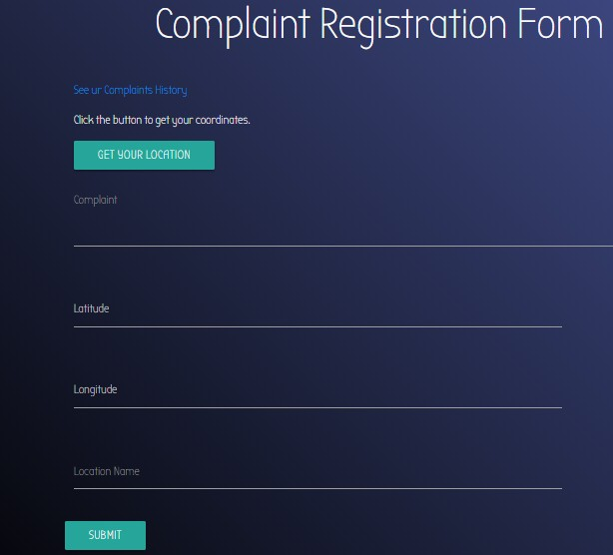
U S E R I N P U T
U s e r w i l l c l i c k t h e l o c a t i o n t r a c k e r
b u t t o n , w h i c h w i l l s t o r e t h e c u r r e n t l o c a t i o n o f t h e
u s e r w h e r e u s e r f o u n d s t h e
g a r b a g e .
T h e u s e r w i l l a l s o m e n t i o n t h e
c o m p l a i n t d e t a i l s .

Slide 6


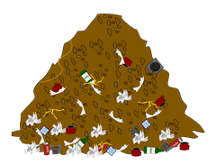

P R O C E S S
Stored in Municipality DB
Request
User Complaint Filed
Response
Garbage Location

Slide 7
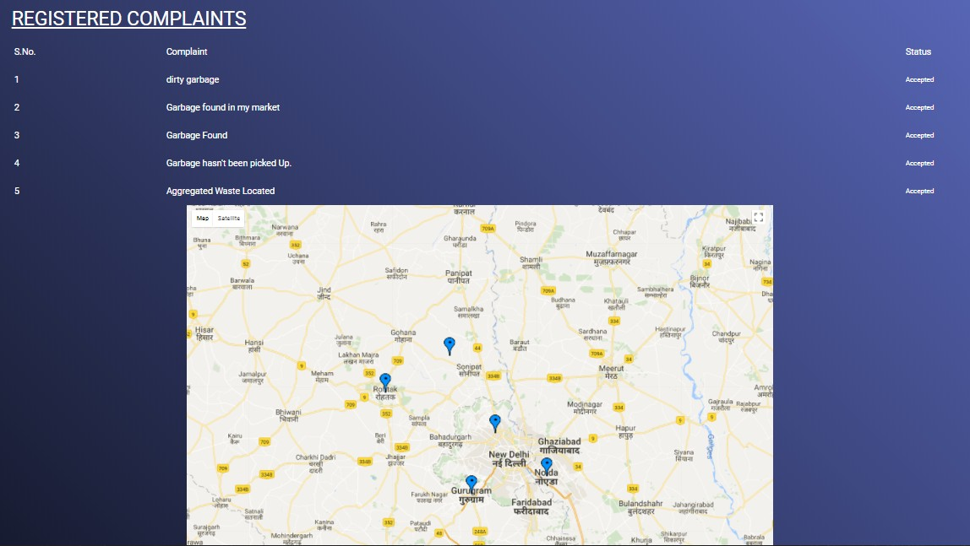
M U N I C I P A L I T Y P O R T A L

Slide 8

BENEFITS OF SWACHH BHARAT WEB APP
E n h an ces I n dian T ou ris m
Can P rev en t Man y D is eas es Can B u ild E co-F rien dly
E n v iron m en t
Can H av e A H appy an d H ealth y S ociety
Can F eel P rou d

Slide 10
THANK YOU!
A P R E S E N T A T I O N B Y M A N I K C H H A B R A A N D A N K U L S I N G H

